Slide 1


Back-End Programming: Flask Secutity and UM
Advanced Programming – 1401-2

Slide 2
What Is a Hashing Algorithm?
Dozens of different hashing algorithms exist, and they all work a little differently. But in each one, people type in data, and the program alters it to a different form.
All hashing algorithms are:
Mathematical. Strict rules underlie the work an algorithm does, and those rules can’t be broken or adjusted.
Uniform. Choose one type of hashing algorithm, and data of any character count put through the system will emerge at a length predetermined by the program.
Consistent. The algorithm does just one thing (compress data) and nothing else.
One way. Once transformed by the algorithm, it’s nearly impossible to revert the data to its original state.
It’s important to understand that hashing and encryption are different functions. You might use them in concert with one another. But don’t use the terms interchangeably.

Slide 3
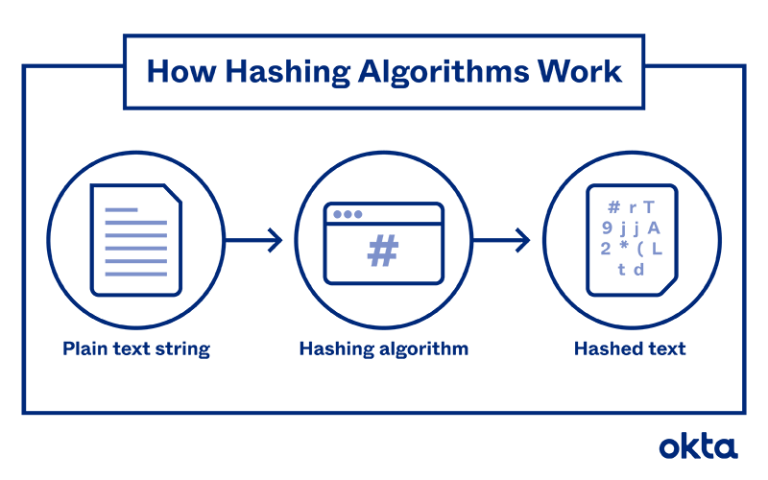
What Is a Hashing Algorithm?

Slide 4
What Is a Hashing Algorithm?
Password storage. You must keep records of all of the username/password combinations people use to access your resources. But if a hacker gains entry, stealing unprotected data is easy. Hashing ensures that the data is stored in a scrambled state, so it's harder to steal.
Digital signatures. A tiny bit of data proves that a note wasn't modified from the time it leaves a user's outbox and reaches your inbox.
Document management. Hashing algorithms can be used to authenticate data. The writer uses a hash to secure the document when it's complete. The hash works a bit like a seal of approval. A recipient can generate a hash and compare it to the original. If the two are equal, the data is considered genuine. If they don't match, the document has been changed.
File management. Some companies also use hashes to index data, identify files, and delete duplicates. If a system has thousands of files, using hashes can save a significant amount of time.

Slide 5
What Is a Hashing Algorithm?
Password storage. You must keep records of all of the username/password combinations people use to access your resources. But if a hacker gains entry, stealing unprotected data is easy. Hashing ensures that the data is stored in a scrambled state, so it's harder to steal.
Digital signatures. A tiny bit of data proves that a note wasn't modified from the time it leaves a user's outbox and reaches your inbox.
Document management. Hashing algorithms can be used to authenticate data. The writer uses a hash to secure the document when it's complete. The hash works a bit like a seal of approval. A recipient can generate a hash and compare it to the original. If the two are equal, the data is considered genuine. If they don't match, the document has been changed.
File management. Some companies also use hashes to index data, identify files, and delete duplicates. If a system has thousands of files, using hashes can save a significant amount of time.

Slide 6
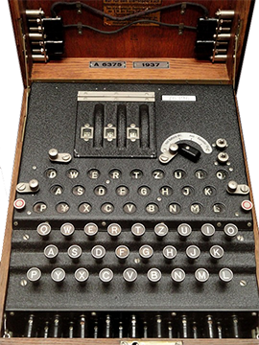
Enigma in WW

Slide 7
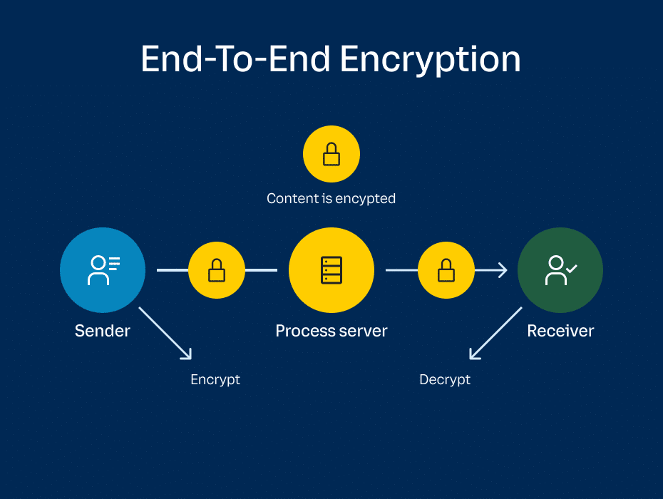
END TO END

Slide 8
END TO END

Slide 9
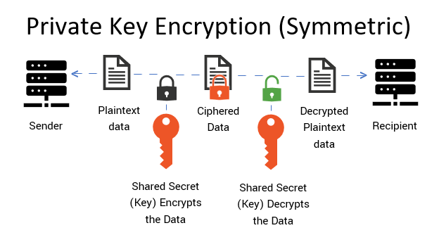
Private Key

Slide 10
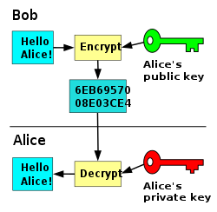
Private Key

